Slide 1
Violence and Abuse
Name:
Course:
Professor:
Date:

Slide 2
Introduction
Exposure to violence, abuse affects not only the individual psychologically but also the Social economic life of the individual e.g. income, education and occupation.
For example, in order for child to reach their goals, they need an environment that will assure them they reach their full potential. Children, adults need ample environment where they can experience positive, and growth to reach their goals. when the environment influences them with negativity e.g. violence, sexual abuse, and many more adverse experiences, they are affected and they may not reach their goals in life (Coogan, 2018).

Slide 3
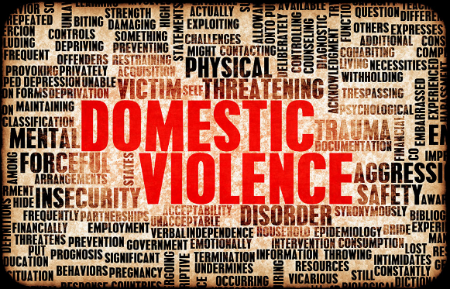
Abuse and Violence

Slide 4
Psychological concerns
When an individual is abused, it might raise some psychological concerns and build into something that is threatening and frightening. The following are some characteristics/signs and symptoms of psychological concerns resulting from abuse, violence;
Isolation from people
Insulting people
Yelling
Threatening others (Foran, 2017).

Slide 5
Psychological concerns Cont.
There are a number of things that could result psychological concerns due to violence or abuse. For example, an abusive relationship could lead to one party feeling belittled, helpless and desperate.
Physical and sexual abuse against someone could lead to injuries and damages the psychology of the individual. For example, wife battering, forced sex and physical attacks.
Emotional abuse is no less destructive. It chips away the self-worth and the independence of the sexual relationship (Foran, 2017).

Slide 6
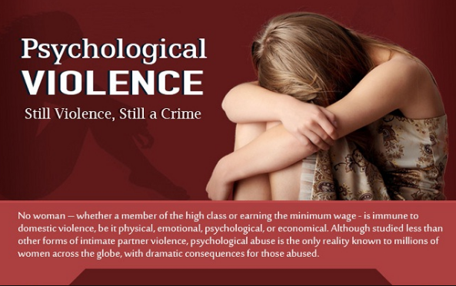
Psychological concerns Cont.

Slide 7
Social economic concerns of abuse and violence
It is essential to treat violence and abuse as a social-economic issue.
In many circumstances, women’s economic status is based on the manner in which they are treated in their homes. The most abused women are poorer while the less affected are wealthier (Wiehe, 2016).
Don’t be violent
Don’t be a sexist- (Good advice)
Be keen on small issues that could be trivial in abuse
It is advisable to reach for help once in abuse which could drain one on social-economic aspects of their life (Foran, 2017).

Slide 8
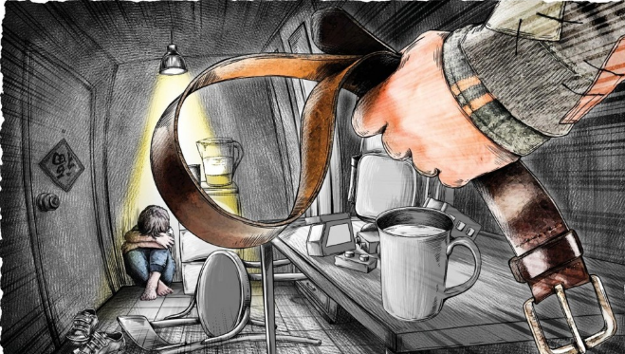
Effects of abuse and violence on women population
Homelessness
Illiteracy e.g. on the girl child
Financial inadequacy
Discrimination
Great economic dependence
Employment instability-Low income levels
Low occupational levels (Gelles, 2017)

Slide 9
References
Coogan, D. (2018). Child to parent violence and abuse: Family interventions with non-violent resistance.
Foran, H. M. (2017). Family problems and family violence: Reliable assessment and the ICD-11. New York, NY: Springer Pub. Co.
Gelles, R. J. (2017). Intimate violence and abuse in families.
Wiehe, V. R. (2016). Understanding family violence: Treating and preventing partner, child, sibling, and elder abuse. Thousand Oaks: Sage Publications.

